Slide 1
CROP PRODUCTION ANALYSIS IIN INDIA

Slide 2
Business Problem
The business problem described in the text revolves around the need for effective and flexible collaboration among numerous stakeholders in the agri-food sector. As the agriculture business domain evolves due to advancements in the Future Internet, there is a growing need for a Business-to-Business (B2B) collaboration platform that can facilitate this collaboration

Slide 3
Details of Data
State Name : This column defines the name of state where the data of crop production is collected.
District Name : It shows the name of the district within the state where data is collected.
Crop Year : This Column defines in which year the crop is harvested.
Season : Season in which crop was grown and gives the production
Crop : Which type of crop is harvested for production
Area : Area of land used for cultivating the crop
Production : Amount of production does the crop produced.

Slide 4
INSIGHTS
Mean of the Production represents average and given by high standard deviation and range it is clear that mean might be skewed by extremely high values.
Median is lower than mean suggesting that the half of data is below average suggesting that data is right skewed.
High variance suggests that spread of data is high.
Skewness is positive means that the data distribution is long right tail and kurtosis is Leptic distribution that means value suggests that data has heavy tail which means the data has extreme values (outliers).

Slide 5
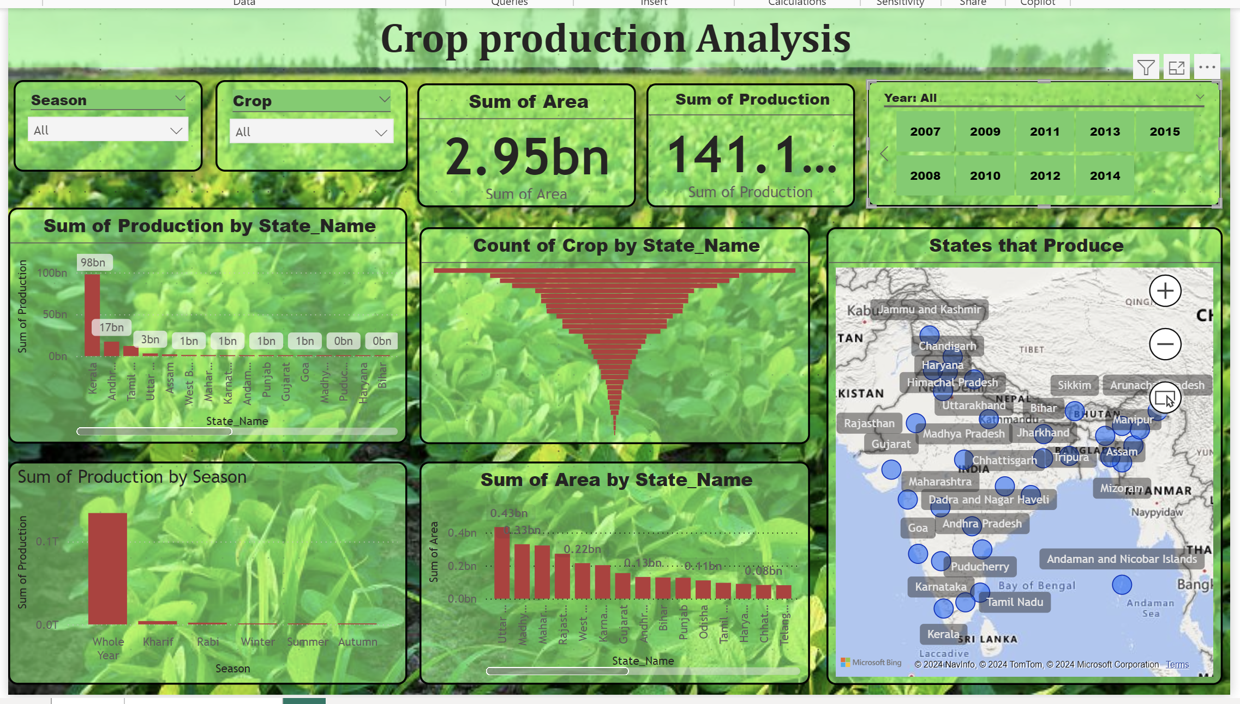
MY DASHBOARD

Slide 6
THANK YOU

